Slide 1

Mini Project-I (K24MCA18P) Odd Semester Session 2024-25
Voice / Text Signal to Visual Indian Sign Language (ISL) Converter
Ankit Kumar Shahi 2426MCA2359
Project Supervisor:
Ms. Divya Singhal
Assistant Professor

Slide 2
Content
Introduction (1 slide)
Literature Review (2 slides)
Objective of the Project (1 slide)
Technology
Hardware Requirements (Development Environment, Server requirement (if required), Client requirement (if required).
Software Requirements (Language and Platforms like Frameworks, VS code, Android Studio and Jupyter notebook etc. )
Modules (2-3 slides)
Workflow (1 slide)
Reports (For Example: Project : Student Monitoring System, so reports like: Student Marks, Subjects, companies visit, and student appears in placement etc.)
References (1 slide)
Notes:
Font Styles: Times New Roman + Font Size: 25

Slide 3
Introduction
The "Voice Signal to Visual Indian Sign Language (ISL) Converter" is designed to facilitate communication between individuals with hearing and speech impairments and those who do not understand sign language. This system converts spoken language into visual ISL gestures, providing a dynamic solution for effective communication.
Notes:
Font Styles: Times New Roman + Font Size: 25

Slide 4
Literature Review
Previous research has explored converting spoken language into sign language, with most efforts concentrated on American Sign Language (ASL) systems. These systems typically use text-to-sign conversion or rely on static images for sign representation. However, limited research has focused on Indian Sign Language (ISL), which lacks the resources and tools seen for other sign languages.
Notes:
Font Styles: Times New Roman + Font Size: 25

Slide 5
Literature Review (Contd.)
Technologies such as speech recognition and natural language processing (NLP) have been widely adopted for ASL systems. These technologies enable voice-to-text conversion, forming the basis of most existing platforms. Sign language visualization is the next challenge, with current methods using 2D or 3D avatars to display gestures of human signers. The need for real-time ISL generation remains largely unmet.
Notes:
Font Styles: Times New Roman + Font Size: 25

Slide 6
Objective of the Project
In India, approximately 5.07 million people who suffer from hearing disability. Among them, more than 30% people are below 20 years of age and about 50% are between 20 years and 60 years of age. These people are generally unable to speak properly because of which they use sign language to communicate with others.
So, our aim is to develop the such type of interface which help to decrease the gap between these two communities. The suggested method are only used to interpret American sign language, not Indian sign language
Notes:
Font Styles: Times New Roman + Font Size: 25

Slide 7
Technology (Hardware Requirements)
Web-Browser
RAM (2GB)
A microphone
A keyboard
Notes:
Font Styles: Times New Roman + Font Size: 25

Slide 8
Technology (Software Requirements)
Backend: Python (Django Framework)
Frontend: JavaScript, HTML, CSS, Bootstrap
Development Tools: VS Code, SQLite for database management.
Operating System: Both Windows and Linux are supported.
Notes:
Font Styles: Times New Roman + Font Size: 25

Slide 9
Modules
User Interface Module : Provides a user-friendly platform where users can easily input their queries and view the generated ISL animations. The interface is intuitive, with options for both voice and text inputs.
Authentication Module : This module handles user registration, login, and authentication. Only registered users can access the website's voice-to-ISL conversion functionality, ensuring secure and personalized usage.
Notes:
Font Styles: Times New Roman + Font Size: 25

Slide 10
Modules (Contd.)
Voice & Text Input Module : Converts spoken queries into text using speech recognition technology. Users also have the option to type their queries directly. This is the first step in the translation process, ensuring accurate capture of user intent and prepares it for ISL conversion.
Sign Language Generation Module : Maps the processed input (either voice or text) to corresponding ISL gestures, converting text into animated signs. This module ensures that the signs accurately represent the input query.
Notes:
Font Styles: Times New Roman + Font Size: 25

Slide 11
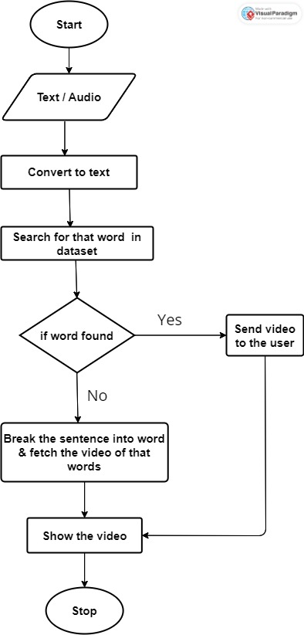
Workflow/Gantt Chart
Notes:
Font Styles: Times New Roman + Font Size: 25

Slide 12
Reports
Show how many voice and text queries the system has handled.
Keep track of the number of users who have logged into the system.
Count how many times the system has successfully converted a query into Indian Sign Language.
Notes:
Font Styles: Times New Roman + Font Size: 25

Slide 13
References
The web framework for perfectionists with deadlines (Django ( https://www.djangoproject.com ))
Django Tutorial (https://realpython.com/tutorials/django/)
JavaScript (https://developer.mozilla.org/en-US/docs/Web/JavaScript (mdn web docs))
Dataset ( https://www.kaggle.com/datasets/koushikchouhan/indian-sign-language-animated-videos )
Notes:
Font Styles: Times New Roman + Font Size: 25

